Slide 1
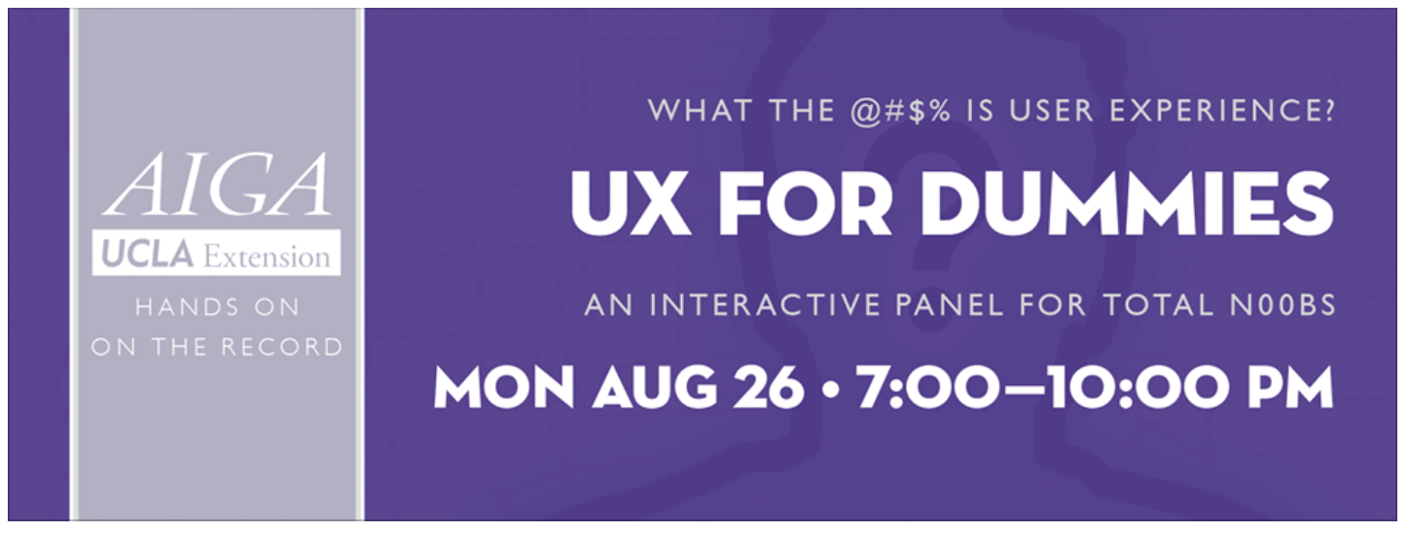
DEFINITION PROCESS DELIVERABLES CHALLENGES
Q&A
Notes:
DEFINITION What the Hell is UX? Look and talk about definitions with panel & audience PROCESS Process Map from different perspectives (agency, education, and corporation) DELIVERABLES User Testing User Research Sitemaps Wireframes CHALLENGES How do I get buy-in from clients for upfront research work that takes time? How do I...

Slide 2








Lynn Boyden Information Architect at USC Information Technology Services
Chris Chandler Senior Director UX at Fandango
Jose Caballer Chief Education Officer of The Skool
Lara Fedoroff
Founder, UX-radio, Inc.

Slide 3
Richard Saul Wurman's definition of Information Architect: 1) the individual who organizes the patterns inherent in data, making the complex clear. 2) a person who creates the structure or map of information which allows others to find their personal paths to knowledge. 3) the emerging 21st century professional occupation addressing the needs of the age focused upon clarity, human understanding, and the science of the organization of information."

Slide 4
information architecture facilitates intuitive access to content
user experience
design of a strategy that brings us to a solution
User’s Needs & Business Goals
Content
Structural Design – IA
Information Design
Navigation Design
Interface Design
Visual Design
Organization Systems
Navigation Systems
Search Systems
Labeling Systems
Answers:
1. Where am I?
2. What’s here?
3. Where can I go from here?
Answers:
1. Is this useful and usable?
2. Can I find [it] easily?
3. Is this valuable?

Slide 5
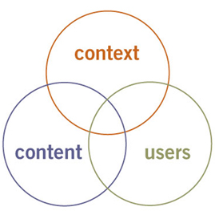
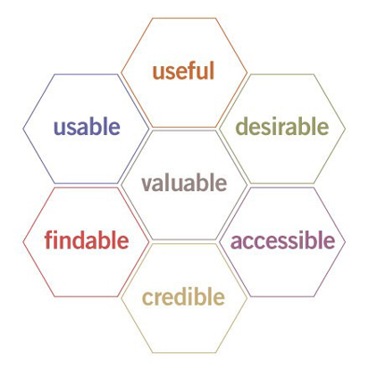
user experience ux honeycomb
*Peter Morville’s UX Honeycomb
information architecture
3 circles of ia
Semantic Studios – http://semanticstudios.com/publications/semantics/000029.php *and friends
Notes:
Peter Morville makes the distinction between information architecture and user experience

Slide 6
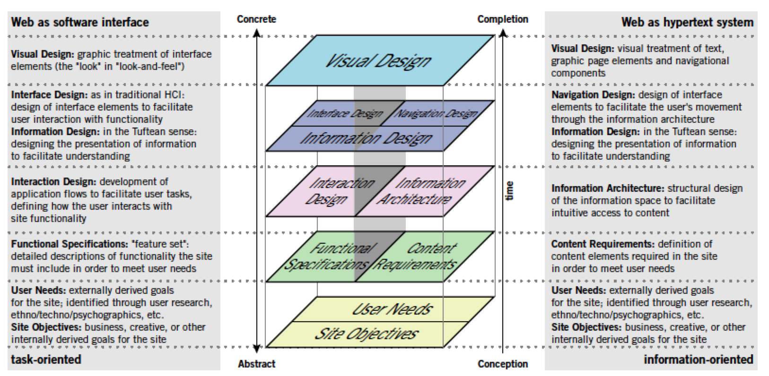
Jesse James Garrett’s Elements of UX
Jesse James Garrett – http://www.jjg.net/elements/pdf/elements.pdf
Notes:
This picture is incomplete. The model outlined here does not account for secondary considerations such as those arising during technical or content development that may infulence decisions during ux development. See the complete diagram.

Slide 7
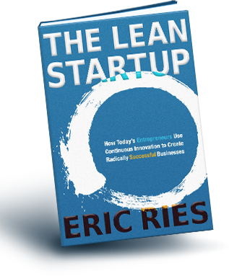
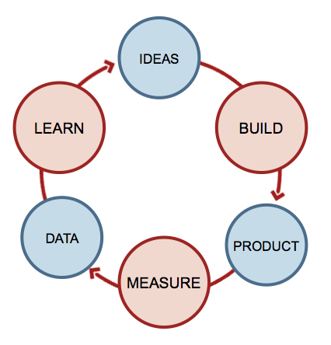
The Lean Startup by Eric Ries
Eric Ries – http://lean.st/principles/build-measure-learn
Notes:
Understanding Lean Principles
Principled and disciplined approach to innovation that allows to build measure and learn rapidly.
A core component of Lean Startup methodology is the build-measure-learn feedback loop. The first step is figuring out the problem that needs to be solved and then developing a minimum viable product (MVP) to begin the process of learning as quickly as possible. Once the MVP is established, a startup can work on tuning the engine. This will involve measurement and learning and must include actionable metrics that can demonstrate cause and effect question.
MVP remove any feature, process, or effort that doesn't contribute directly to the learning you seek.

Slide 8
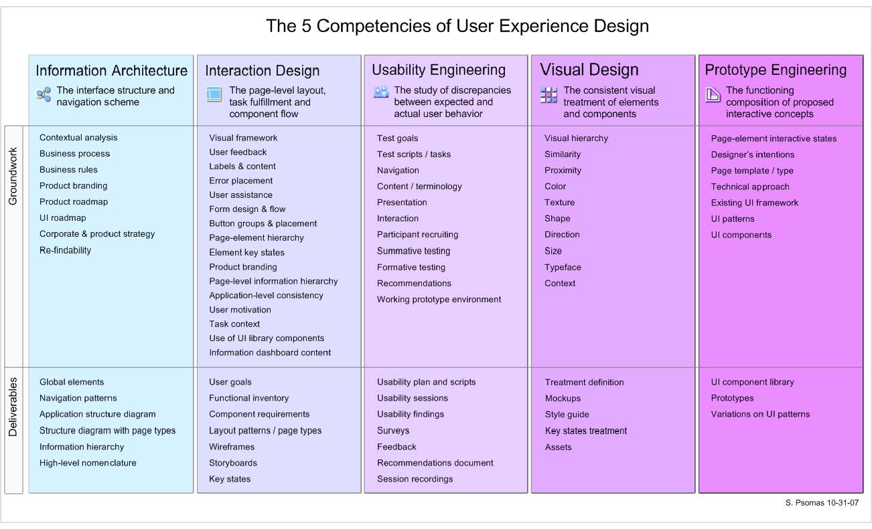
Steve Psomas’ 5 competencies of UX
UX Matters – http://www.uxmatters.com/mt/archives/2007/11/images/FiveCompetencies.pdf
Notes:
UX Matters includes IA as part of UX

Slide 9
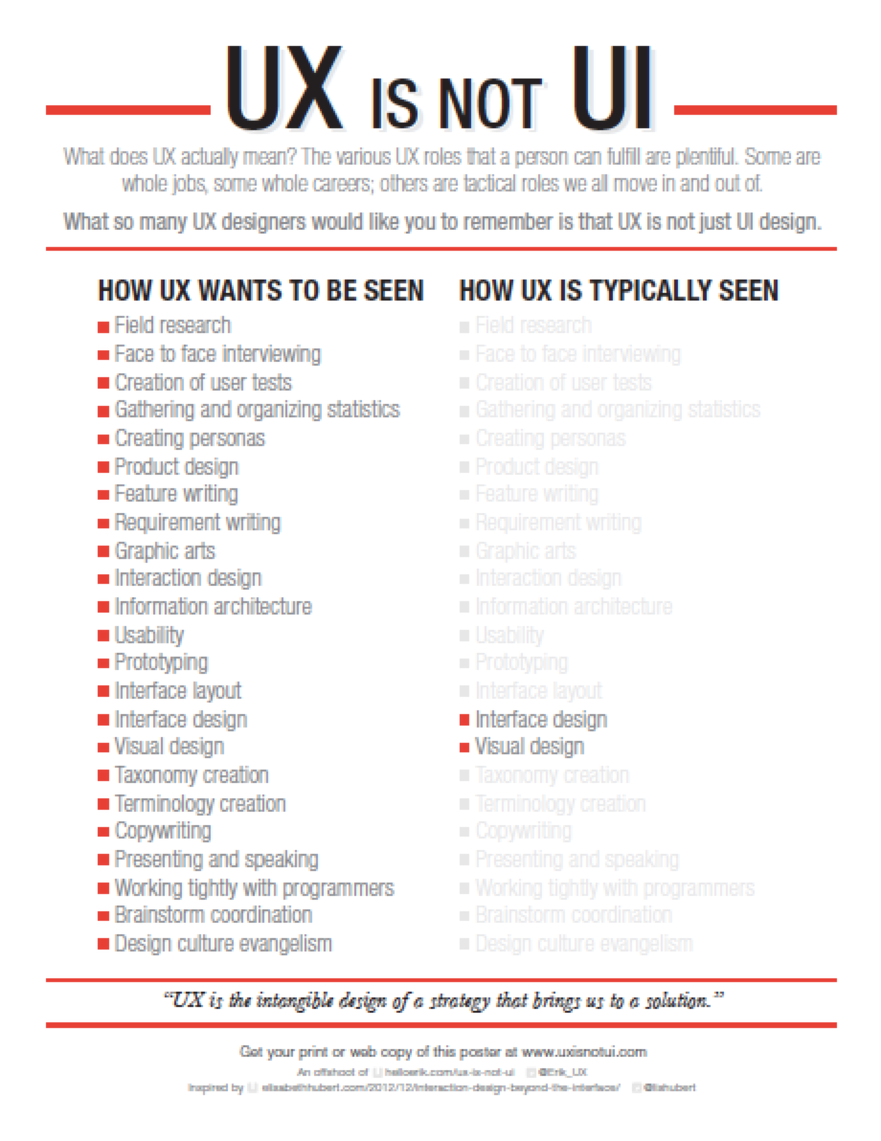
Erik Flowers – UX is Not UI
“UX is the intangible design of a strategy that brings us to a solution.”
Erik Flowers – http://www.helloerik.com/ux-is-not-ui

Slide 10
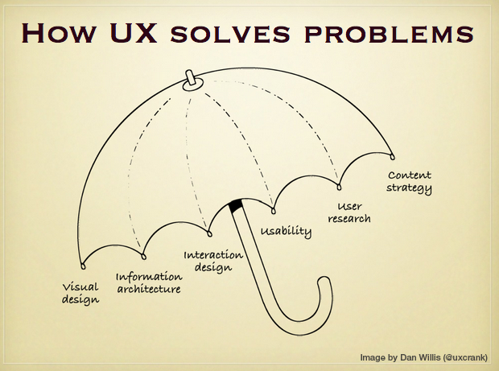
Dan Willis’ Umbrella, ella, ella
Dan Willis, UX Crank – http://dswillis.com/uxcrank/

Slide 11
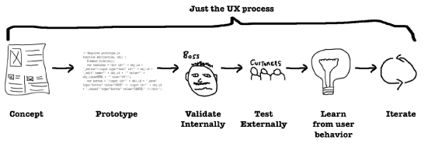
Jeff Gothelf’s Lean UX: Getting Out of the Deliverables Business
Wireframes, site maps, flow diagrams, content inventories, taxonomies, mockups and the ever-sacred specifications document
Jeff Gothelf’s http://uxdesign.smashingmagazine.com/2011/03/07/lean-ux-getting-out-of-the-deliverables-business/
Notes:
It’s about the experience we create not the documents.

Slide 12

Process Maps
Join the LAUX Meetup!
Semantic Studios – http://semanticstudios.com/publications/semantics/000029.php
Jesse James Garrett – http://www.jjg.net/elements/pdf/elements.pdf
Eric Ries – http://lean.st/principles/build-measure-learn
Steve Psomas – http://www.uxmatters.com/mt/archives/2007/11/images/FiveCompetencies.pdf
Erik Flowers – http://www.helloerik.com/ux-is-not-ui
Dan Willis, UX Crank – http://dswillis.com/uxcrank/
Jeff Gothelf’s http://uxdesign.smashingmagazine.com/2011/03/07/lean-ux-getting-out-of-the-deliverables-business/
Coursera’s Human Computer Interaction Class by Scott Klemmer

Slide 13
Books
Accelerando by Charles Stross
Communicating Design; Developing web site documentation for design and planning by Dan Brown
The Design of Everyday Things by Donald A. Norman
Designing Interfaces; Patterns for an Effective Interaction Design by Jenifer Tidwell
Don't Make Me Think: A Common Sense Approach to Web Usability by Steve Krug
The Elements of User Experience: User-Centered Design for the Web by Jesse James Garrett
Envisioning Information AND The Visual Display of Quantitative Information by Edward R. Tufte

Slide 14
Books
Flawless Consulting; Getting your expertise Used by Peter Block
Information Architecture for the World Wide Web by Louis Rosenfeld and Peter Morville
Inmates are Running the Asylum: why high-tech products drive us crazy and how to restore the sanity by Alan Cooper
The Lean Startup by Eric Ries
Paper Prototyping: the fast and easy way to design and refine user interfaces by Carolyn Snyder
Pervasive Information Architecture by Andrea Resmini and Luca Rosati
Running Lean by Ash Maurya
More book recommendations? Go here:
http://rosenfeldmedia.com/uxzeitgeist/books
http://www.fatdux.com/en/Resources/Book-reviews

Slide 15
Comments
“I like that each panelist had a different angle.”
“I felt like I was finally part of the conversation!”
“This was our most well-attended event!”
Add more here…

